Slide 1

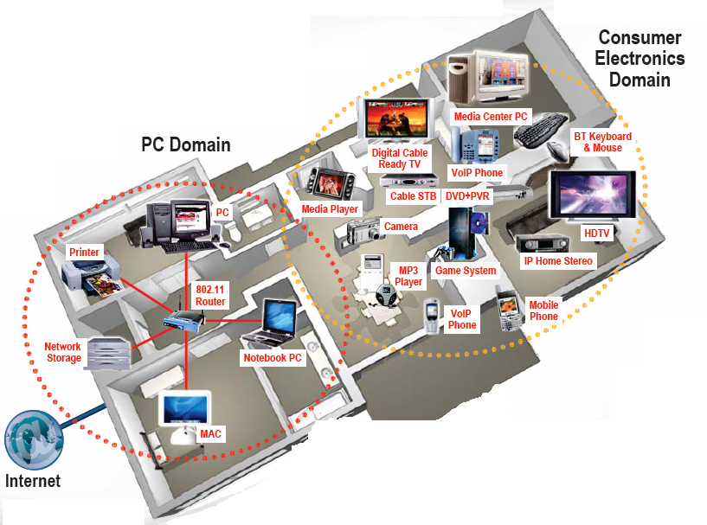

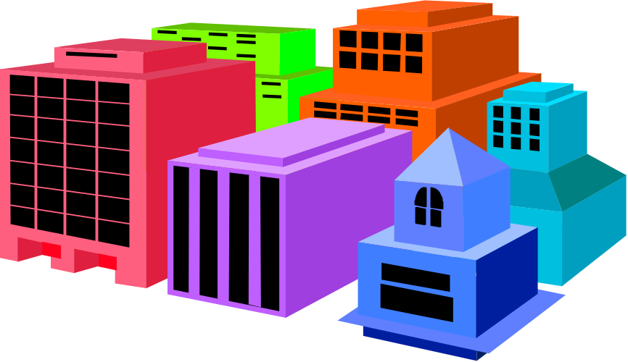


EE 359: Wireless Communications
Bonus Lecture

Slide 2
Topics
Future wireless networks
Wireless network design challenges
Cellular systems: evolution and their future
Wireless standards: .11n, .16 (Wimax), LTE
Ad-hoc and sensor networks
Cognitive and software-defined radios
Cross-layer design
Biological applications of wireless
Research vs. industry challenges
EE360
EE360
EE360
EE360

Slide 3

Future Wireless Networks
Ubiquitous Communication Among People and Devices
Next-generation Cellular
Wireless Internet Access
Wireless Multimedia
Sensor Networks
Smart Homes/Spaces
Automated Highways
In-Body Networks
All this and more …

Slide 4
Wireless Network Design Issues
Multiuser Communications
Multiple and Random Access
Cellular System Design
Ad-Hoc Network Design
Network Layer Issues
Cross-Layer Design

Slide 5

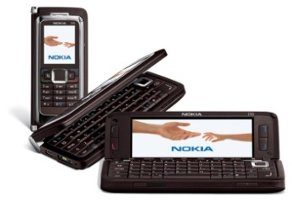
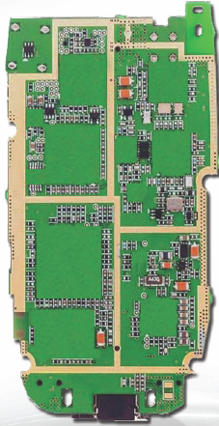

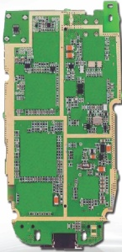




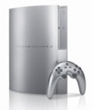

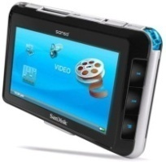
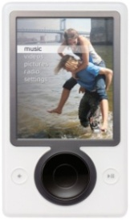
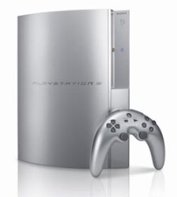
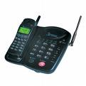
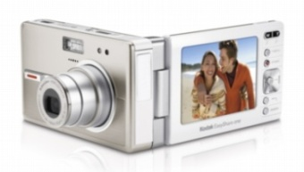
Future Cell Phones/PDAs
Everything Wireless in One Device
San Francisco
BS
BS
Internet
New York
Switch
Control
Bell
System
Switch
Control
BS
Much better performance and reliability than today
- Gbps data rates, low latency, 99% coverage, coexistance

Slide 6
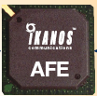
Challenges
Network Challenges
  Scarce spectrum
  Demanding applications
  Reliability
  Ubiquitous coverage
  Seamless indoor/outdoor operation
Device Challenges
  Size, Power, Cost
  MIMO in Silicon
  Multiradio Integration
  Coexistance
BT
FM/XM
GPS
Cellular
DVB-H
Apps
Processor
WLAN
Media
Processor
Wimax

Slide 7
Software-Defined Radio
BT
FM/XM
A/D
Cellular
GPS
A/D
DVB-H
DSP
Apps
Processor
A/D
WLAN
Media
Processor
Wimax
A/D
Multiband antennas and wideband A/Ds span the bandwidth of all desired signals
The DSP is programmed to process the desired signal based on carrier frequency, signal shape, etc.
Avoids specialized hardware
Today, this is not cost, size, or power efficient

Slide 8
Cellular System Evolution
Reuse channels to maximize capacity
1G: Analog systems, large frequency reuse, large cells, uniform standard
2G: Digital systems, less reuse (1 for CDMA), smaller cells, multiple standards, evolved to support voice and data (IS-54, IS-95, GSM)
3G: Digital systems, WCDMA competing with GSM evolution.
BASE
STATION
MTSO

Slide 9
3G Cellular Design:
Voice and Data
Data is bursty, whereas voice is continuous
  Typically require different access and routing strategies
3G “widened the data pipe”:
  384 Kbps (802.11n has 100s of Mbps).
  Standard based on wideband CDMA
  Packet-based switching for both voice and data
  3G cellular popular in Asia/Europe, IPhone driving growth
Evolution of existing systems in US (2.5G++)
    GSM+EDGE, IS-95(CDMA)+HDR
    100 Kbps may be enough
    Dual phone (2/3G+Wifi) use growing (iPhone, Google)
What is beyond 3G?
The trillion dollar question

Slide 10
Next-Generation Cellular
Long Term Evolution (LTE)
OFDM/MIMO (the PHY wars are over)
Much higher data rates (50-100 Mbps)
Greater spectral efficiency (bits/s/Hz)
Flexible use of up to 100 MHz of spectrum
Low packet latency (<5ms).
Increased system capacity
Reduced cost-per-bit
Support for multimedia

Slide 11
Technology Innovations for 4G
Exploiting multiple antennas
Better modulation and coding
Better MAC/scheduling
Removing interference (MUD)
Exploiting Interference
  Cooperation and cognition
Picocells and Femtocells
Cross-Layer Design
Networked/Cooperative MIMO

Slide 12
MIMO in Cellular:
Performance Benefits
Antenna gain ⇒ extended battery life, extended range, and higher throughput
Diversity gain ⇒ improved reliability, more robust operation of services
Multiplexing gain ⇒ higher data rates
Interference suppression (TXBF) ⇒ improved quality, reliability, robustness
Reduced interference to other systems

Slide 13
Cooperative/Network MIMO
How should MIMO be fully exploited?
At a base station or Wifi access point
  MIMO Broadcasting and Multiple Access
Network MIMO: Form virtual antenna arrays
  Downlink is a MIMO BC, uplink is a MIMO MAC
  Can treat “interference” as a known signal or noise
  Can cluster cells and cooperate between clusters

Slide 14

Multiplexing/diversity/interference cancellation tradeoffs in MIMO networks
Interference
Stream 2
Stream 1
Spatial multiplexing provides for multiple data streams
TX beamforming and RX diversity provide robustness to fading
TX beamforming and RX nulling cancel interference
Optimal use of antennas in wireless networks unknown

Slide 15
Coverage Indoors and Out:
The Role of Femtocells
Cellular (Wimax) versus Mesh
Outdoors
Indoors
Femtocell
Wifi Mesh
  Cellular has good coverage outdoors
  Relaying increases reliability and range (can be done with handsets)
  Wifi mesh has a niche market outdoors
  Hotspots/picocells enhance coverage, reliability, and data rates.
  Multiple frequencies can be leveraged to avoid interference
  Cellular cannot provide reliable indoor coverage
  Wifi networks already ubiquitous in the home
  Alternative is a consumer-installed Femtocell
  Winning solution will depend on many factors

Slide 16
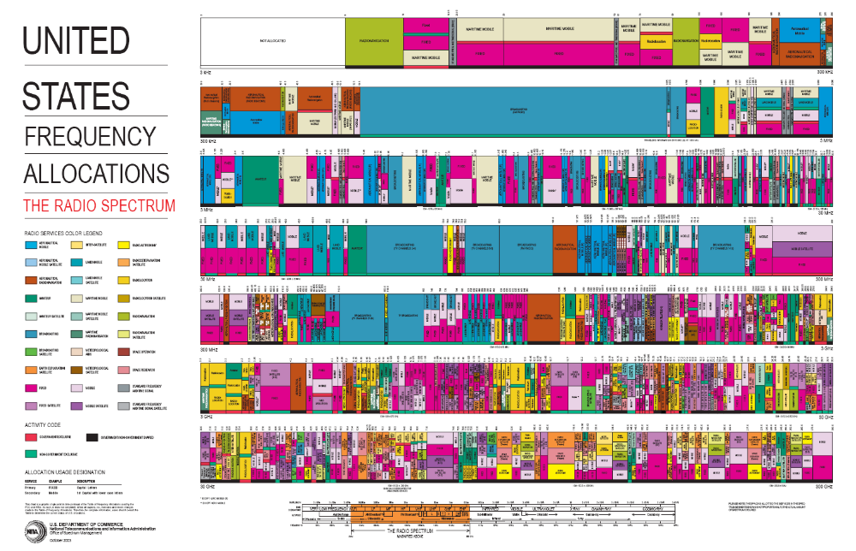
Scarce Wireless Spectrum
$$$
and Expensive

Slide 17

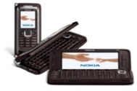

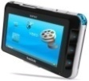
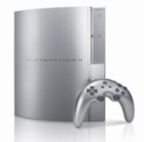

Spectral Reuse
Due to its scarcity, spectrum is reused
In licensed bands
and unlicensed bands
BS
Cellular, Wimax
Wifi, BT, UWB,…
Reuse introduces interference

Slide 18
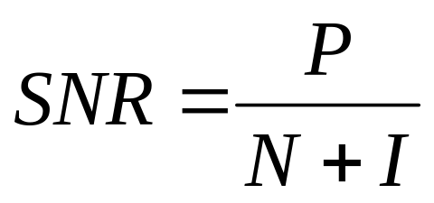
Interference: Friend or Foe?
If treated as noise: Foe
If decodable: Neither friend nor foe
Increases BER, reduces capacity
Multiuser detection can
completely remove interference

Slide 19
Ideal Multiuser Detection
Signal 1
-
=
Signal 1
Demod
Iterative
Multiuser
Detection
Signal 2
Signal 2
Demod
-
=
Why Not Ubiquitous Today?
Power and A/D Precision

Slide 20
If exploited via cooperation and cognition
Interference: Friend or Foe?
Friend
Especially in a network setting

Slide 21
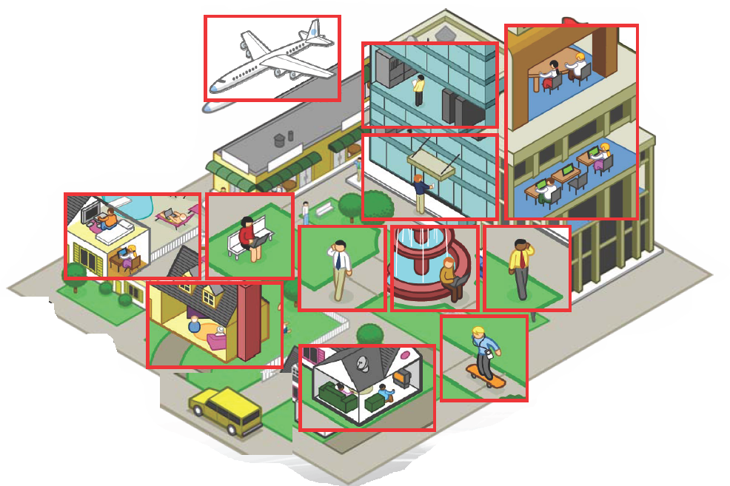
Ad-Hoc/Mesh Networks
ce
Outdoor Mesh
Indoor Mesh

Slide 22
Cooperation in Wireless Networks
Many possible cooperation strategies:
  Virtual MIMO , generalized relaying, interference forwarding, and one-shot/iterative conferencing
Many theoretical and practice issues:
  Overhead, forming groups, dynamics, synch, …

Slide 23
General Relay Strategies
TX1
RX1
X₁
Y₄=X₁+X₂+X₃+Z₄
relay
Y₃=X₁+X₂+Z₃
X₃= f(Y₃)
Y₅=X₁+X₂+X₃+Z₅
X₂
TX2
RX2
Can forward message and/or interference
  Relay can forward all or part of the messages
    Much room for innovation
  Relay can forward interference
    To help subtract it out

Slide 24
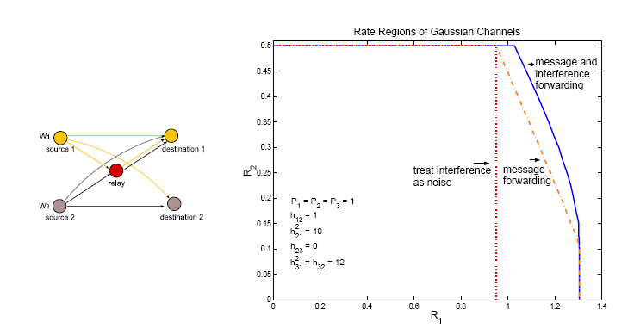
Beneficial to forward both interference and message

Slide 25
Intelligence beyond Cooperation: Cognition
Cognitive radios can support new wireless users in existing crowded spectrum
  Without degrading performance of existing users
Utilize advanced communication and signal processing techniques
  Coupled with novel spectrum allocation policies
Technology could
  Revolutionize the way spectrum is allocated worldwide
  Provide sufficient bandwidth to support higher quality and higher data rate products and services

Slide 26
Cognitive Radio Paradigms
Underlay
  Cognitive radios constrained to cause minimal interference to noncognitive radios
Interweave
  Cognitive radios find and exploit spectral holes to avoid interfering with noncognitive radios
Overlay
  Cognitive radios overhear and enhance noncognitive radio transmissions
Knowledge
and
Complexity

Slide 27
Underlay Systems
Cognitive radios determine the interference their transmission causes to noncognitive nodes
  Transmit if interference below a given threshold
The interference constraint may be met
  Via wideband signalling to maintain interference below the noise floor (spread spectrum or UWB)
  Via multiple antennas and beamforming
I_{P}
NCR
NCR
CR
CR

Slide 28
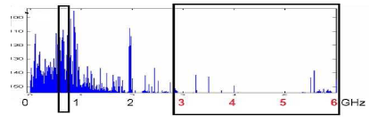
Interweave Systems
Measurements indicate that even crowded spectrum is not used across all time, space, and frequencies
  Original motivation for “cognitive” radios (Mitola’00)
These holes can be used for communication
  Interweave CRs periodically monitor spectrum for holes
  Hole location must be agreed upon between TX and RX
  Hole is then used for opportunistic communication with minimal interference to noncognitive users

Slide 29
Overlay Systems
Cognitive user has knowledge of other user’s message and/or encoding strategy
  Used to help noncognitive transmission
  Used to presubtract noncognitive interference
CR
RX1
RX2
NCR

Slide 30
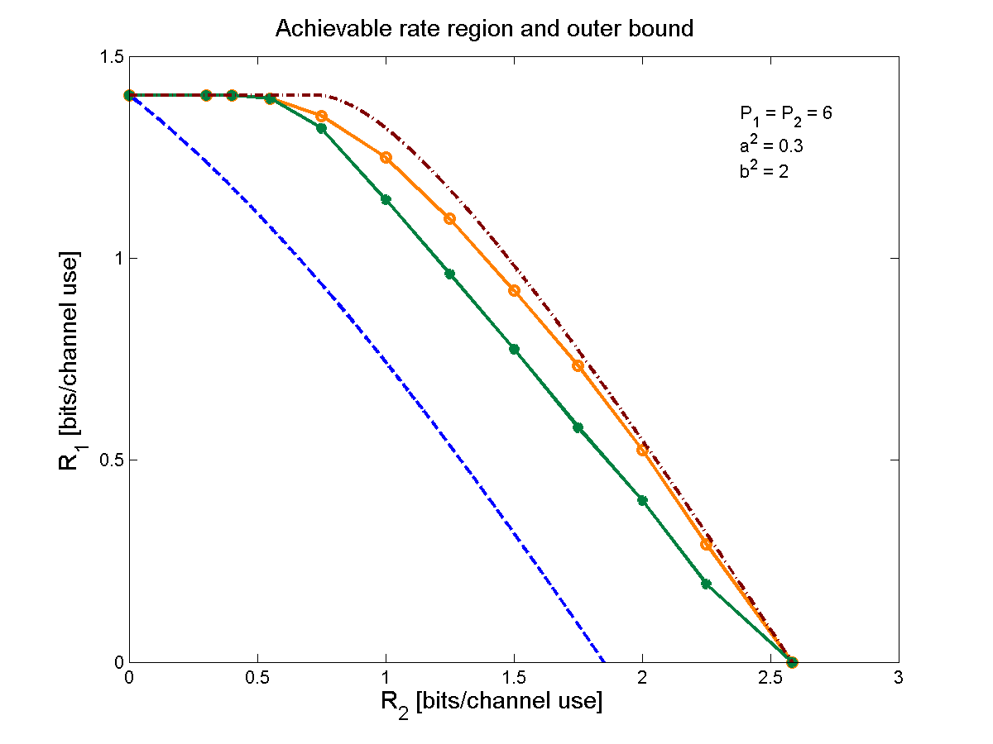
Performance Gains from Cognitive Encoding
  outer bound
  our scheme
  prior schemes
  Only the CR
  transmits
Regulatory bodies have not made much progress here

Slide 31
Crosslayer Design in Ad-Hoc Wireless Networks
Application
Network
Access
Link
Hardware
Substantial gains in throughput, efficiency, and end-to-end performance from cross-layer design
Notes:
Interdisciplinary research, design, and development very challenging, but necessary to meet the requirements of future wireless applications

Slide 32
Delay/Throughput/Robustness across Multiple Layers
B
A
Multiple routes through the network can be used for multiplexing or reduced delay/loss
Application can use single-description or multiple description codes
Can optimize optimal operating point for these tradeoffs to minimize distortion

Slide 33
Cross-layer protocol design for real-time media
Loss-resilient
source coding
and packetization
Application layer
Rate-distortion preamble
Congestion-distortion
optimized
scheduling
Transport layer
Congestion-distortion
optimized
routing
Traffic flows
Network layer
Capacity
assignment
for multiple service
classes
Link capacities
MAC layer
Link state information
Adaptive
link layer
techniques
Joint with T. Yoo, E. Setton,
X. Zhu, and B. Girod
Link layer

Slide 34
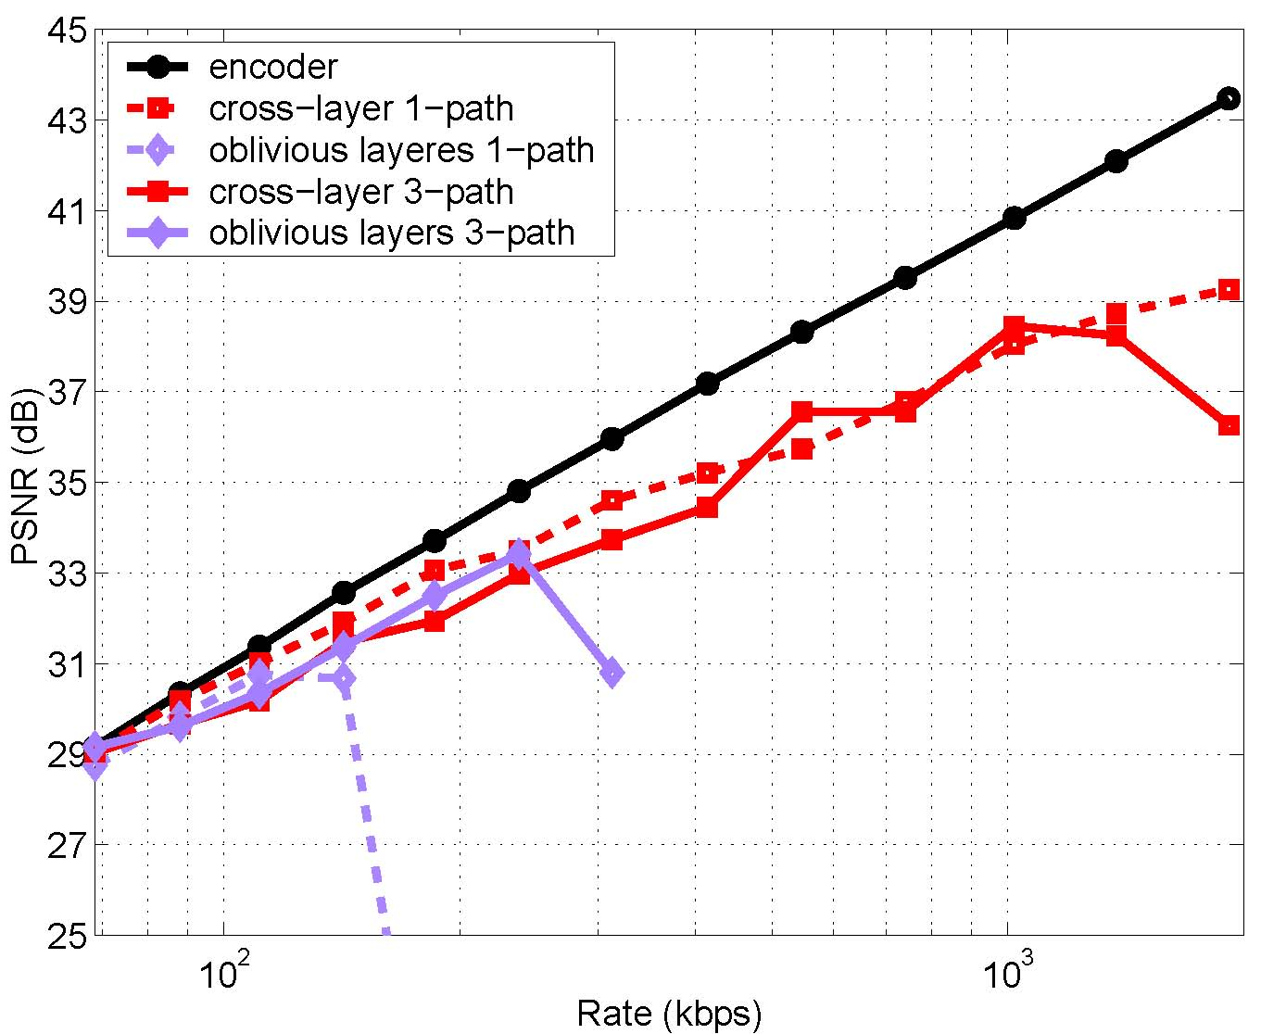
Video streaming performance
s
5 dB
3-fold increase
100
1000
(logarithmic scale)

Slide 35
New Applications
(besides high-rate multimedia communication everywhere)

Slide 36
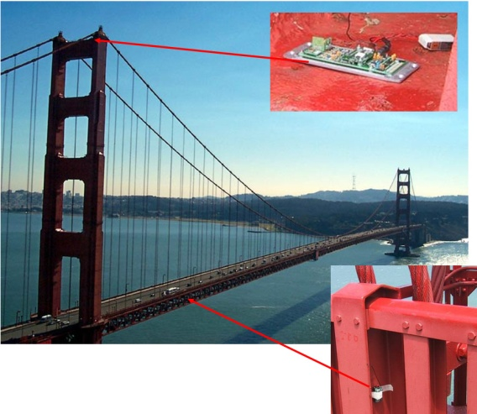
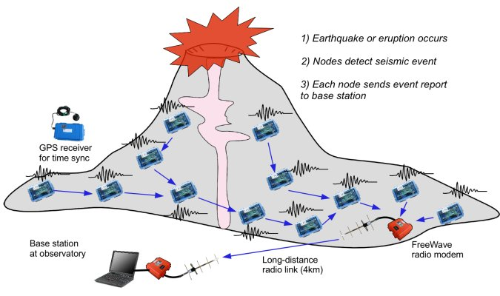
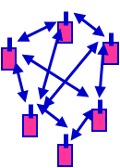
Wireless Sensor Networks
Smart homes/buildings
Smart structures
Search and rescue
Homeland security
Event detection
Battlefield surveillance
Energy is the driving constraint
Data flows to centralized location
Low per-node rates but tens to thousands of nodes
Intelligence is in the network rather than in the devices

Slide 37
Energy-Constrained Nodes
Each node can only send a finite number of bits.
  Transmit energy minimized by maximizing bit time
  Circuit energy consumption increases with bit time
  Introduces a delay versus energy tradeoff for each bit
Short-range networks must consider transmit, circuit, and processing energy.
  Sophisticated techniques not necessarily energy-efficient.
  Sleep modes save energy but complicate networking.
Changes everything about the network design:
  Bit allocation must be optimized across all protocols.
  Delay vs. throughput vs. node/network lifetime tradeoffs.
  Optimization of node cooperation.
Notes:
All the sophisticated high-performance communication techniques developed since WW2 may need to be thrown out the window.
By cooperating, nodes can save energy

Slide 38

Distributed Control over Wireless Links
Automated Vehicles
- Cars
- UAVs
- Insect flyers
  - Different design principles
    Control requires fast, accurate, and reliable feedback.
    Networks introduce delay and loss for a given rate.
  - Controllers must be robust and adaptive to random delay/loss.
  - Networks must be designed with control as the design objective.

Slide 39
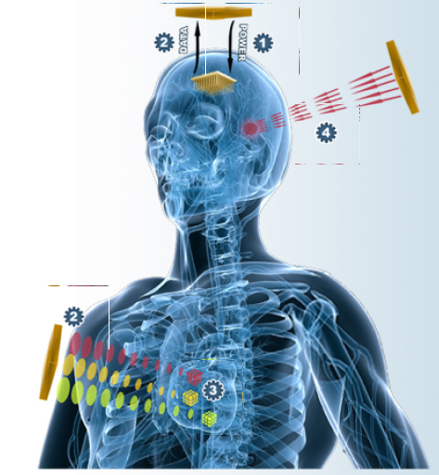
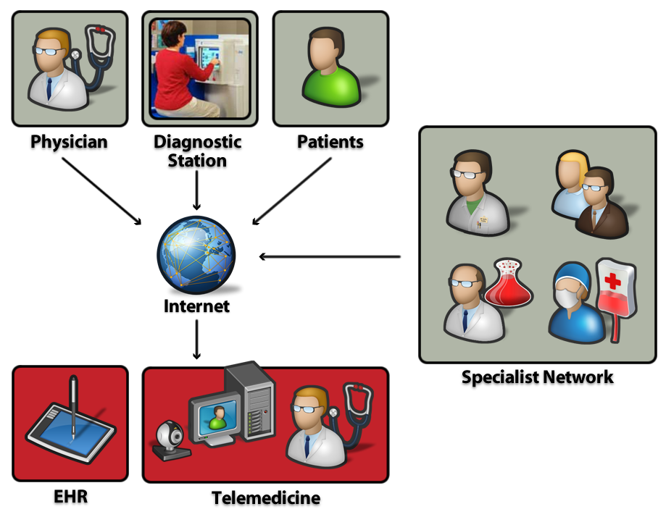
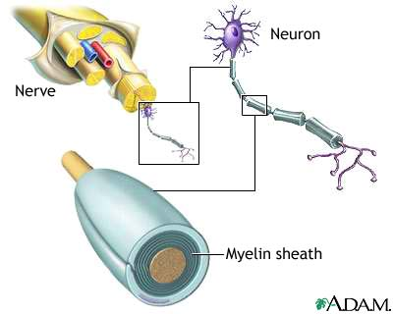
Wireless Biomedical Systems
Wireless
Network
Wireless Telemedicine
In- Body Wireless Devices
Sensors/monitoring devices
Drug delivery systems
Medical robots
Neural implants
Recovery from
Nerve Damage

Slide 40


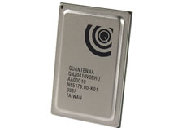
Research vs. Industry
Many innovations from communication/network theory can be implemented in a real system in 3-12 months
  Industry is focused on implementation issues such as size, complexity, cost, and development time.
Theory heavily influences current and next-gen. wireless systems (mainly at the PHY & MAC layers)
  Idealized assumptions have been liberating
  Above PHY/MAC little theory and hence few real breakthroughs
Industry people read our papers and implement our ideas
Launching a startup is the best way to do tech transfer
We need more/better ways to exploit academic innovation

Slide 41

The End
Thanks! You guys have been great!!!!
Have a great winter break

